Slide 1
«Introduction to WebRTC (Web Real-Time Communication)»

Slide 2
Idea – everybody needs a secure way of communicating

Slide 3
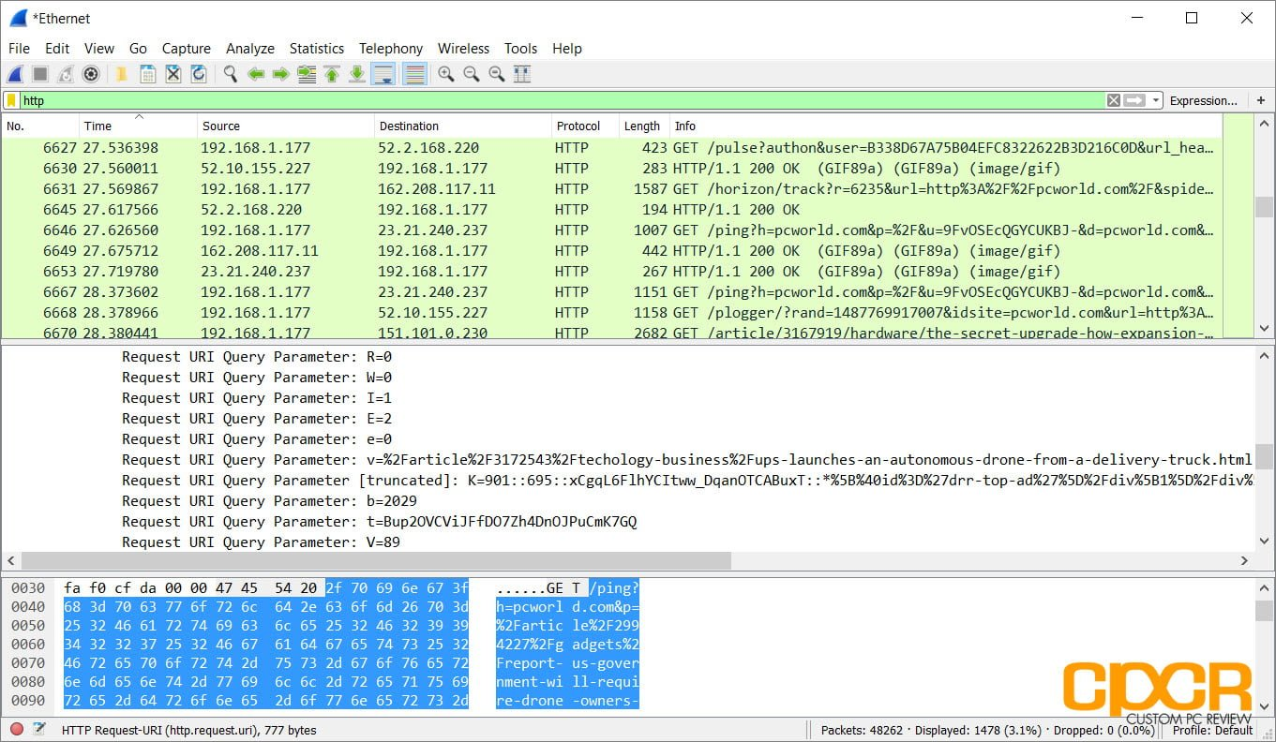
Your communication must be secured
Web-sniffers allow to see others unsecured traffic

Slide 4
Alternative solutions
Has no 3rd party call integration
Uses server in-between
Has no real-time data streaming

Slide 5

What our software provides
Invitation of opponents for a call;
Realtime audio and video streaming;
Secured data streaming;
Support for low-speed internet connections;
Incoming call notifications;
Muting of audio while in a call;
Muting of audio while in a call.

Slide 6
Existing threats to open networks IP-spoofing or Man-in-the-middle attacks
3

Slide 7
Existing threats to open networks IP-sniffing or packets capture
3

Slide 8
HTTPS must be used by default HTTPS provides the first basic level of security
3

Slide 9
DTLS is the second level of security (Datagram Transport Layer Security)
DTLS is used for keys exchange Keys are used for data encryption
3

Slide 10
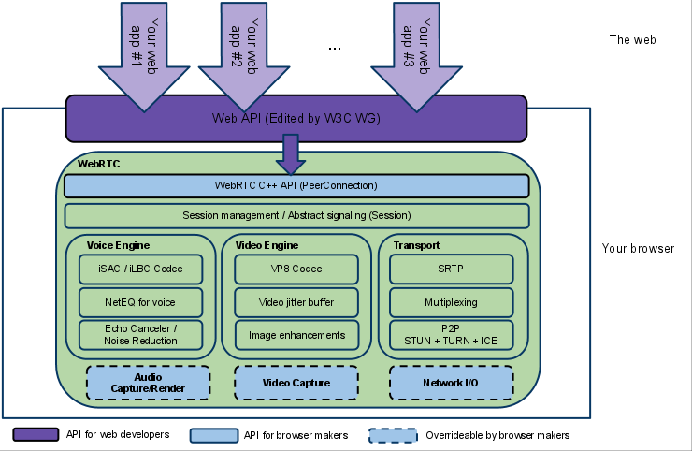
WebRTC internal structure
WebRTC technology for secured communication
3

Slide 11
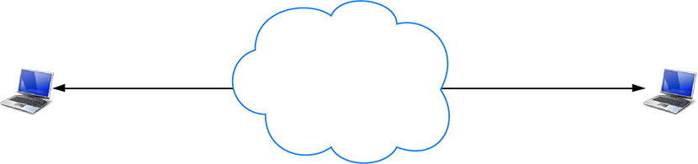
Technical details
A world without routers(NAT) and firewalls

Slide 12
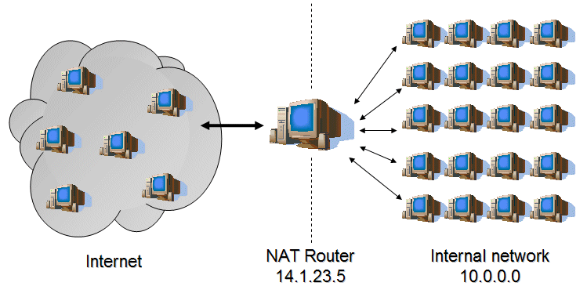
NAT: Network address translation
NAT — it is a router, translator, firewall

Slide 13
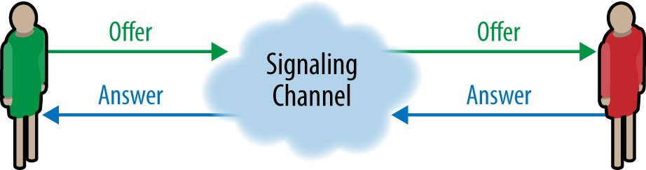
Establishing a connection between devices

Slide 14
Types of signaling messages
Offer for a call (offer)
Answer for a call (answer)
System messages (hang up, reject)
ICE candidates

Slide 15










ICE candidates
It's possible channels of communication between users
GPRS
Local network or WI-FI
3G
EDGE
Information

Slide 16
ICE candidates
ICE candidates – channels of communication between users
3G
EDGE Wi-Fi
Local network
Bluetooth
And others

Slide 17
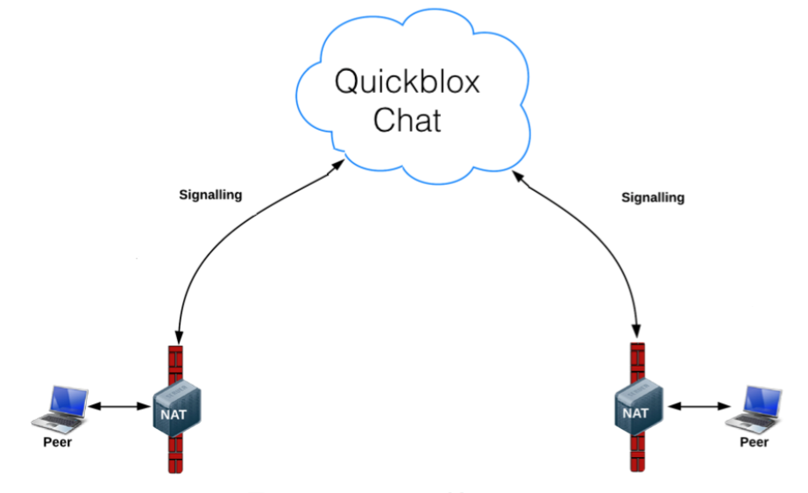
How the real world works
Signaling
channel

Slide 18
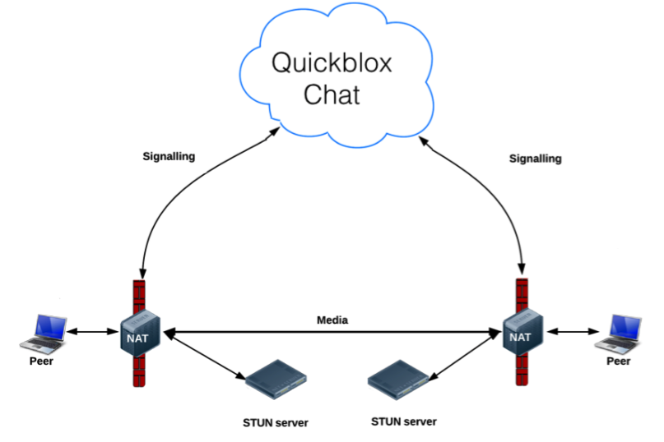
Using of STUN server for retrieving IP-address
Signaling
channel

Slide 19
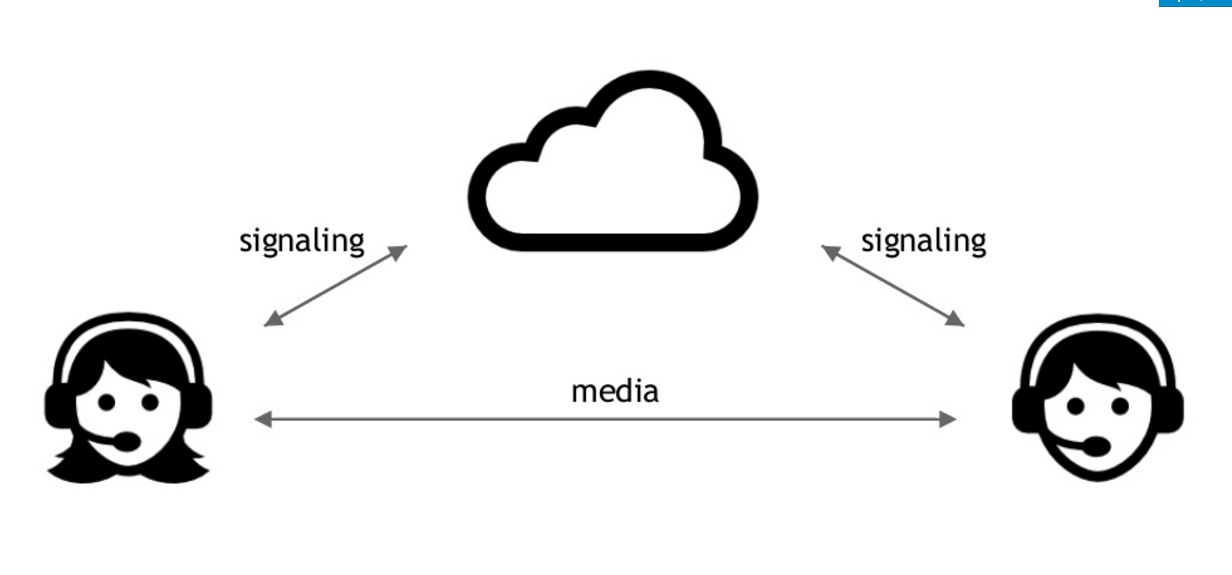
The whole picture

Slide 20
How does it work?
The whole picture

Slide 21
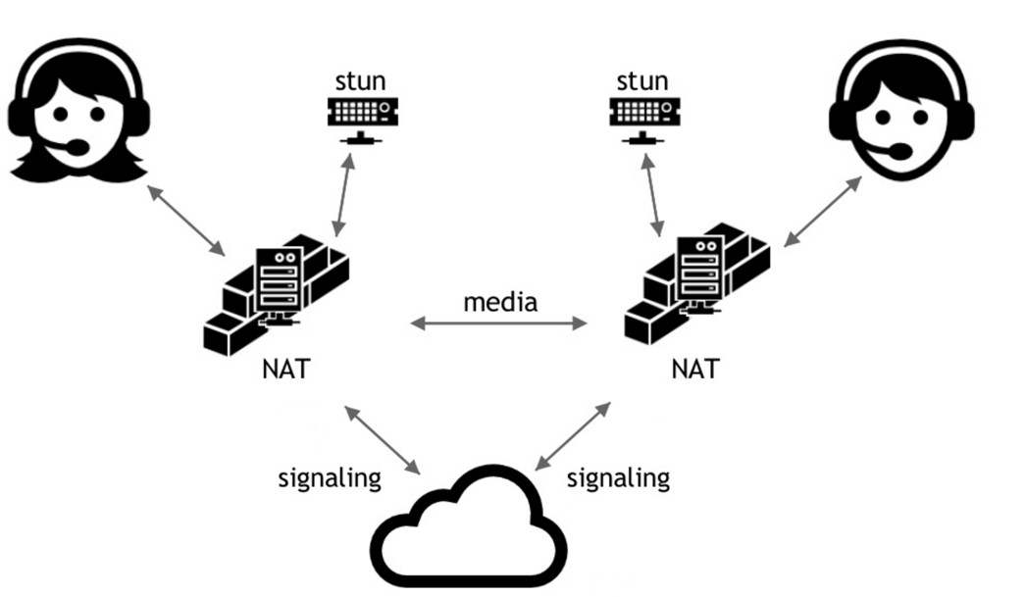

Slide 22
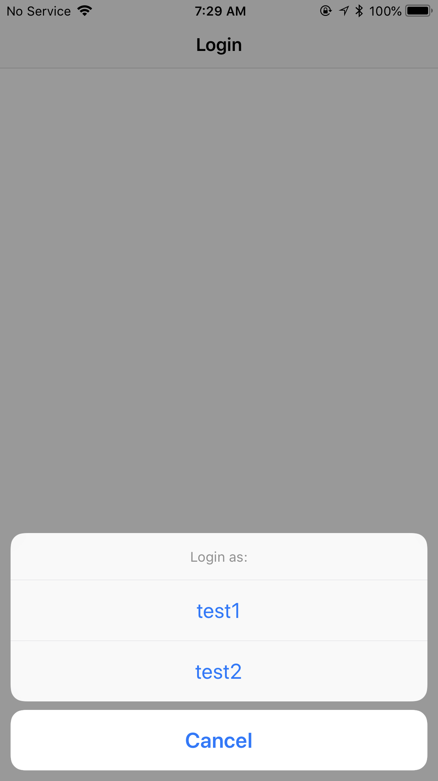
User interface
1
2
3

Slide 23
Conclusions
WebRTC is a technology for peer-to-peer communication;
WebRTC is secured by default using SRTP and DTLS encryption;
WebRTC is perfectly suited for low-speed connections such as EDGE, GPRS, 2G;
WebRTC requires signaling channel – WebSockets, XMPP, Jabber, REST Chat etc.;
ICE candidates are generated by WebRTC and represent a list of possible ways of communication;
STUN server is required to retrieve a public IP-address;
TURN server(not covered in this presentation) is used for a more stable audio-video data streaming;

Slide 24
Thank you!

